Slide 1
EE5907/EE5027 Week 4: Logistic Regression
BT Thomas Yeo
ECE, CIRC, Sinapse, Duke-NUS, HMS

Slide 2
Last Week Recap
Univariate Gaussian
ML, MAP, posterior predictive
Notes:
Last week, we discussed how to perform ML, MAP and posterior predictive distribution for univariate gaussian.

Slide 3
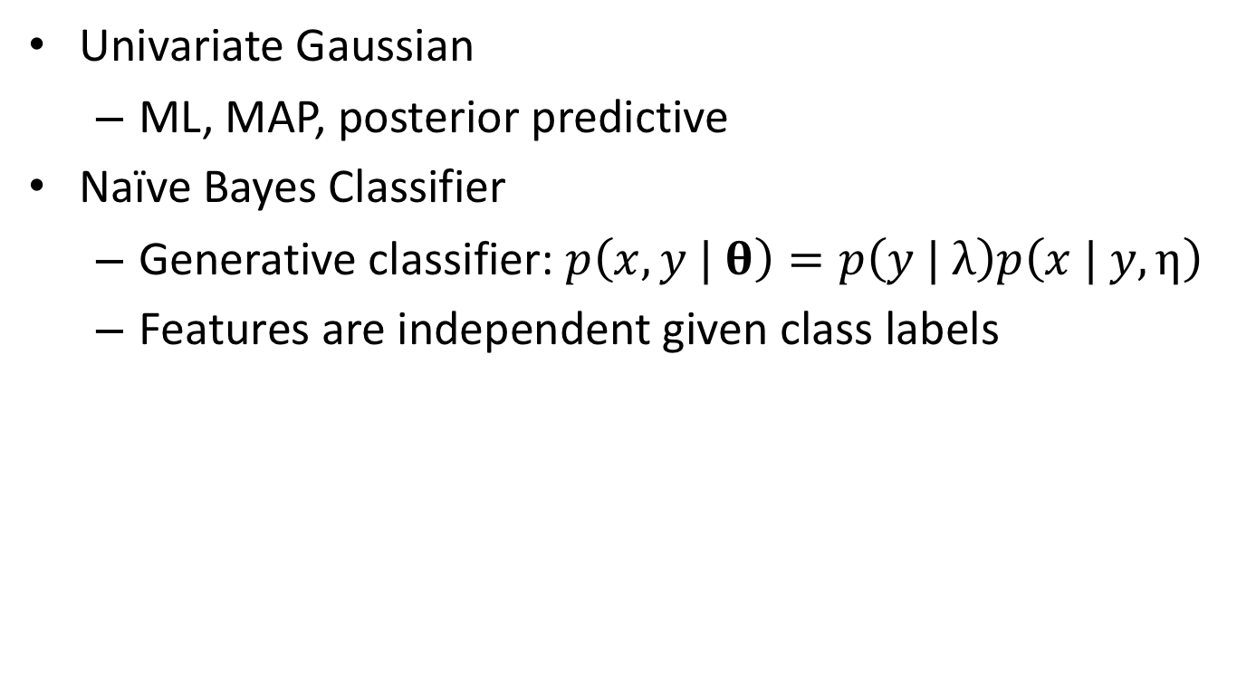
Last Week Recap
Univariate Gaussian
ML, MAP, posterior predictive
Naïve Bayes Classifier
Generative classifier: $p\left(x, y | \text{θ}\right)=p\left(y | λ\right)p\left(x | y,η\right)$
Features are independent given class labels
Notes:
We then talk about our first generative classifier: Naïve Bayes.
Where we assume that the features x are independent conditioned on knowing the class labels y.

Slide 4
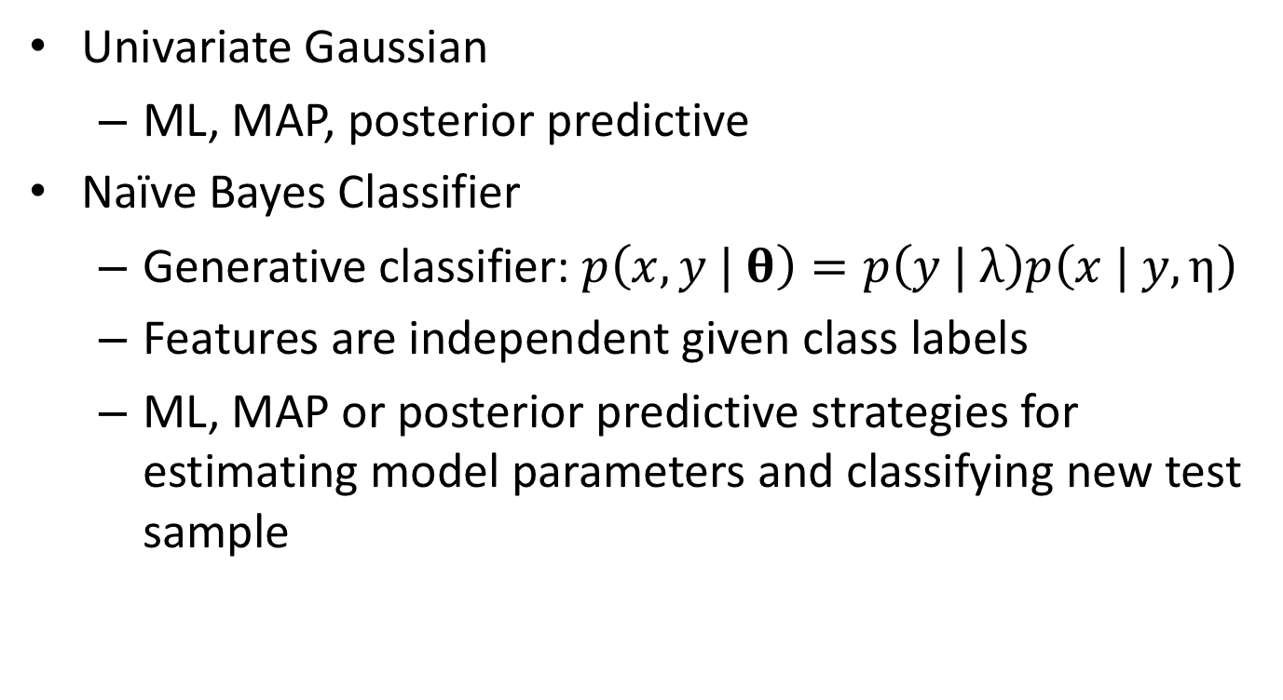
Last Week Recap
Univariate Gaussian
ML, MAP, posterior predictive
Naïve Bayes Classifier
Generative classifier: $p\left(x, y | \text{θ}\right)=p\left(y | λ\right)p\left(x | y,η\right)$
Features are independent given class labels
ML, MAP or posterior predictive strategies for estimating model parameters and classifying new test sample
Notes:
And then we talk about three strategies to learn the naïve Bayes model parameters and classify new test samples.

Slide 5
This Week
Discriminative Classifier
Logistic regression
Basic optimization techniques
Notes:
In contrast, today I want to introduce you to a discriminative classifier, called logistic regression.
This allows me to introduce you to some basic optimization techniques that are relevant even for many state of the art techniques such as deep neural networks.

Slide 6
Questions?
Notes:
Any questions before I continue?

Slide 7
Logistic Regression
Notes:
Let’s start with Logistic Regression.

Slide 8
Logistic Regression Model
Notes:
Let’s consider the problem of classification. Given features x, we want to predict class label y.
A generative classifier is one that builds a joint probability distribution p of x and y. The parameters of the joint distribution are estimated from training data where we are given training pairs of x and y.
Once we have trained the classifier, given a new data point x, we can compute the posterior probability of class label y given x
This is called a generative classifier, because we can generate new samples of features x AND class label y from the joint probability distribution.

Slide 9
Logistic Regression Model
Notes:
On the other hand, a discriminative classifier directly models the posterior probability p of y given x.
The parameters of the posterior distribution is estimated from training data again consisting of pairs of features x and class labels y
Once we have trained the classifier, given a new data point x, we can compute the posterior probability of class label y given x
This is called a discriminative model, because we model the posterior probability directly. We cannot generate new data points based on the discriminative model.

Slide 10
Logistic Regression Model
Notes:
Today, I want to introduce you to a basic discriminative classifier called logistic regression.
Despite the name “regression”, this is a discriminative classifier.

Slide 11
Logistic Regression Model
Notes:
Let’s first consider the binary case, where y is either class label 1 or class label 0.
In logistic regression, the posterior probability of the class label y given the features x is parameterized by the parameters w.
We assume that y is a bernoulli random variable where mu is the probability of success. Mu is itself a function of features x and parameters w. So mu of x and w is the probability that y is equal to class label 1.

Slide 12
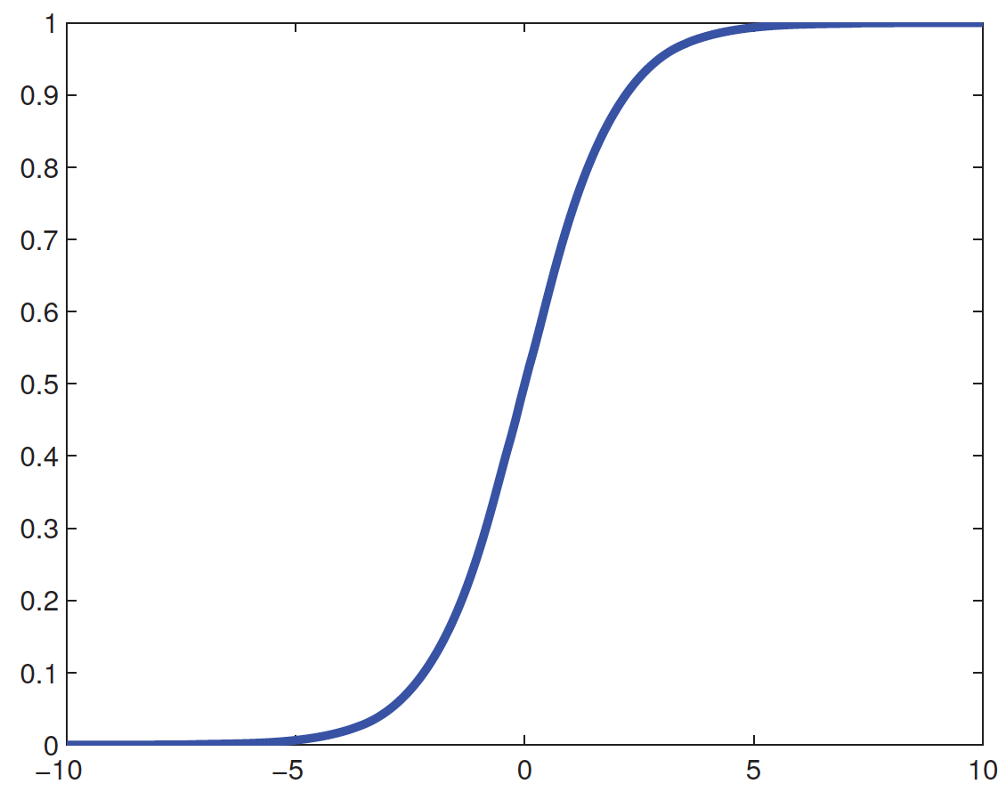
Logistic Regression Model
Notes:
More specifically, we assume that mu of x and w is equal to the sigmoid of w transpose TIMES x.
Recall that the sigmoid function is equal to 1 over 1 + e to the negative x.
So x is a vector of features and w is also a vector. w transpose TIMES x is the inner product between w and x, which gives us a number.
We then pass this number through the sigmoid function. So if w transpose x is big, then the sigmoid output is close to 1, and we have a high posterior probability of y belonging to class label 1.
And if w transpose x is very negative, then the sigmoid output is close to 0 and we have a lower posterior probability of y belonging to class label 0.

Slide 13
Logistic Regression Advantages
Notes:
There are many advantages to logistic regression.
First of all, it is easy to train. I will discuss the training process later in the class.

Slide 14
Logistic Regression Advantages
Notes:
It is also easy to interpret.
As I have said before, the posterior probability that the class label y is equal to 1, given the features x is EQUAL to 1 over 1 + e to the negative w transpose x.
Note that I have suppressed the dependence on w on the left hand side to simplify the notation.

Slide 15
Logistic Regression Advantages
Notes:
the posterior probability that the class label y is equal to 0, given the features x is EQUAL to 1 MINUS the posterior probability that the class label is equal to 1.
So 1 MINUS the expression on top.

Slide 16
Logistic Regression Advantages
Notes:
Which we can simplify to become 1 over 1 + e to the POSITIVE w transpose x.
So notice that for y equal to 1, we have e to the negative w transpose x.
For y equal to 0 we have e to the POSITIVE w transpose x.

Slide 17
Logistic Regression Advantages
Notes:
So if we take the log of the ratio of the two probabilities: so log of the posterior probability that y is equal to 1 DIVIDED by the posterior probability that y is equal to 0, then we get w transpose x.

Slide 18
Logistic Regression Advantages
Notes:
This ratio is called log odds.

Slide 19
Logistic Regression Advantages
Notes:
Now, suppose we want to predict cancer, so y = 1 implies cancer. y = 0 implies no cancer.
Suppose we have two features. So x(1) is the number of cigarettes smoked per day and x(2) is minutes of exercise per week.
Suppose we estimate from our training data that w is equal to 1.3 and -1.1.

Slide 20
Logistic Regression Advantages
Notes:
Then we can interpret this as for every extra cigarette we smoke, cancer risk increases by e to the power of 1.3.
Similarly, for every extra minute of exercise, cancer risk decreases by e to the power of -1.1
So far so good?

Slide 21
Logistic Regression Advantages
Notes:
It is also easy to extend logistic regression to multiple classes. We won’t cover this in class, but you can find it in the hidden slides.

Slide 22
Logistic Regression Advantages
Notes:
We can also make it nonlinear using kernels. This is not something we will cover in our class.

Slide 23
Questions
Notes:
Any questions?

Slide 24
Training Logistic Regression Model
Notes:
Now let’s figure out how to train the logistic regression model.

Slide 25
Estimating Logistic Regression Parameters & Classifying New Samples
Given training set {x_{1:N}, y_{1:N}}, where x_{1:N} are feature vectors of N training samples and y_{1:N} are corresponding class labels
Notes:
So we have training dataset D, consisting of features x1 to xN and class labels y1 to yN

Slide 26
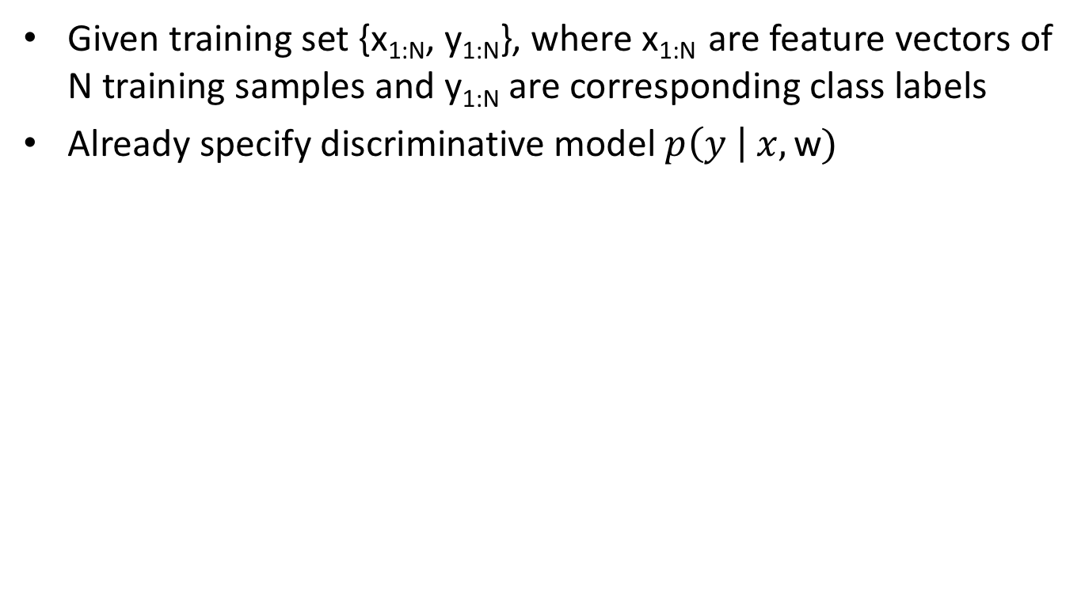
Estimating Logistic Regression Parameters & Classifying New Samples
Given training set {x_{1:N}, y_{1:N}}, where x_{1:N} are feature vectors of N training samples and y_{1:N} are corresponding class labels
Already specify discriminative model $p\left(y \right| x, \text{w})$
Notes:
We have already specified the discriminative model p of class label y GIVEN feature x and parameters w.

Slide 27
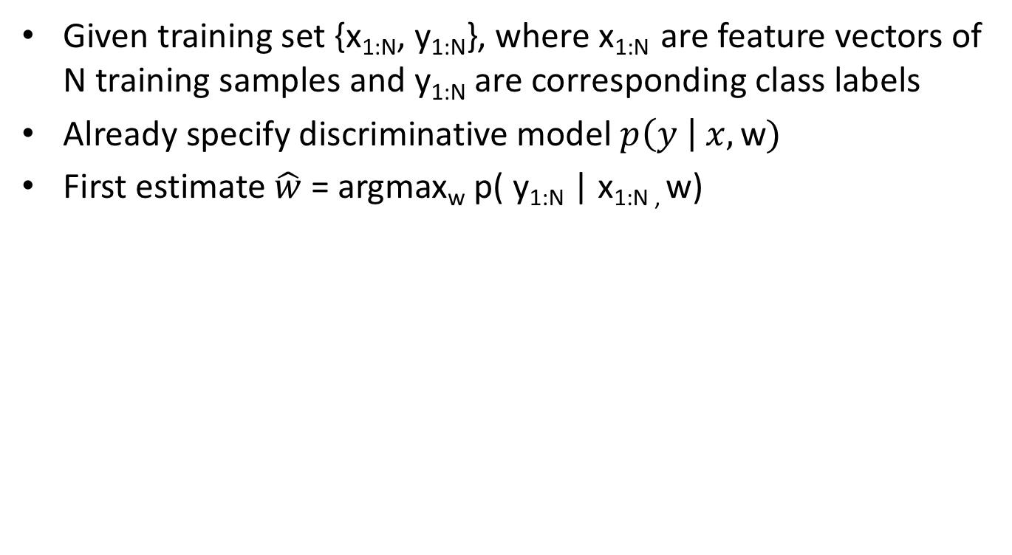
Estimating Logistic Regression Parameters & Classifying New Samples
Given training set {x_{1:N}, y_{1:N}}, where x_{1:N} are feature vectors of N training samples and y_{1:N} are corresponding class labels
Already specify discriminative model $p\left(y \right| x, \text{w})$
First estimate $\hat{w}$ = argmax_{w} p( y_{1:N} | x_{1:N ,} w)
Notes:
We first estimate w by optimizing the posterior p of all class labels y1 to yN GIVEN the features of all data samples x1 to xN and the parameters w.

Slide 28
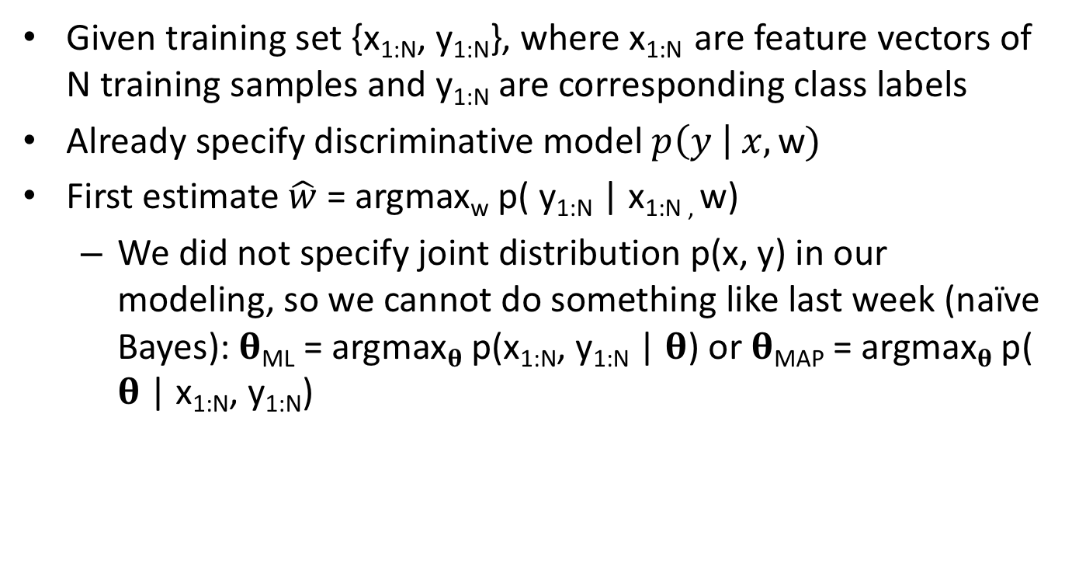
Estimating Logistic Regression Parameters & Classifying New Samples
Given training set {x_{1:N}, y_{1:N}}, where x_{1:N} are feature vectors of N training samples and y_{1:N} are corresponding class labels
Already specify discriminative model $p\left(y \right| x, \text{w})$
First estimate $\hat{w}$ = argmax_{w} p( y_{1:N} | x_{1:N ,} w)
We did not specify joint distribution p(x, y) in our modeling, so we cannot do something like last week (naïve Bayes): 𝛉_{ML} = argmax_{𝛉} p(x_{1:N}, y_{1:N} | 𝛉) or 𝛉_{MAP} = argmax_{𝛉} p( 𝛉 | x_{1:N}, y_{1:N})
Notes:
Notice that this optimization is different from last week when we talk about naïve Bayes.
In naives bayes, we optimize the joint distribution of p of x1 to xN and y1 to yN GIVEN theta OR p of theta GIVEN x1 to xN, y1 to yN.
We cannot do this here because in the discriminative approach, we don’t actually model the joint distribution.

Slide 29
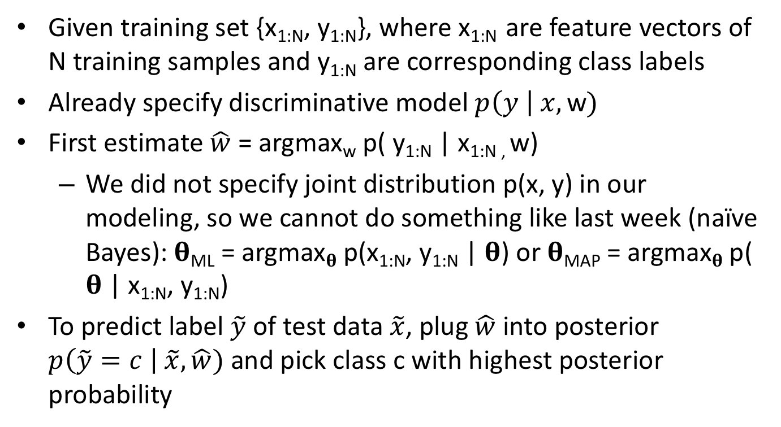
Estimating Logistic Regression Parameters & Classifying New Samples
Given training set {x_{1:N}, y_{1:N}}, where x_{1:N} are feature vectors of N training samples and y_{1:N} are corresponding class labels
Already specify discriminative model $p\left(y \right| x, \text{w})$
First estimate $\hat{w}$ = argmax_{w} p( y_{1:N} | x_{1:N ,} w)
We did not specify joint distribution p(x, y) in our modeling, so we cannot do something like last week (naïve Bayes): 𝛉_{ML} = argmax_{𝛉} p(x_{1:N}, y_{1:N} | 𝛉) or 𝛉_{MAP} = argmax_{𝛉} p( 𝛉 | x_{1:N}, y_{1:N})
To predict label $\tilde{y}$ of test data $\tilde{x}$, plug $\hat{w}$ into posterior $p\left(\tilde{y}=c \right| \tilde{x},\hat{w})$ and pick class c with highest posterior probability
Notes:
Once we have estimated w hat.
Given a new test data x tilde, we can plug w hat into the posterior p of y tilde equal to class c GIVEN x tilde and w hat
We evaluate this for different class c and we pick the class c with the highest posterior probabilty

Slide 30
Minimizing Negative Log Likelihood
Notes:
This equation is from the previous slide.
We want to find w hat that maximizes the posterior distribution p of all class labels y1 to yN GIVEN the features of all data samples x1 to xN and the parameters w.

Slide 31
Minimizing Negative Log Likelihood
Log is monotonic
Notes:
Log is monotonic so we can apply log and not change the location of the maximum.

Slide 32
Minimizing Negative Log Likelihood
Log is monotonic
Samples are independent
Notes:
The training samples xi, yi are independent, so p of y1 to yN given x1 to xN and w becomes product from I = 1 to N p of yi GIVEN xi and w.

Slide 33
Minimizing Negative Log Likelihood
Log is monotonic
Samples are independent
log ab = log a + log b
Notes:
Since log of a TIMES b is equal to log of a + log of b, then the product INSIDE the log becomes the sum OUTSIDE the log.

Slide 34
Minimizing Negative Log Likelihood
Log is monotonic
Samples are independent
log ab = log a + log b
argmax_{x} f(x) = argmin_{x} -f(x)
Notes:
At this point, we flip the sign of the objective function. So now instead of maximizing, we are minimizing.

Slide 35
Minimizing Negative Log Likelihood
Log is monotonic
Samples are independent
log ab = log a + log b
argmax_{x} f(x) = argmin_{x} -f(x)
Notes:
Let’s call this final expression negative log likelihood or NLL.
This is no real advantage to minimizing versus maximizing, but I am following the book’s convention.

Slide 36
Expanding Negative Log Likelihood
Notes:
From the previous slides, we know that the posterior probability that y is equal to 1 is 1 over 1 + e to the NEGATIVE w transpose x
And posterior probability that y is equal to 0 is 1 – the probability that y is equal to 1

Slide 37
Expanding Negative Log Likelihood
Notes:
We can take the log.

Slide 38
Expanding Negative Log Likelihood
Notes:
Recall that mu is posterior probability that y belongs to class 1, which is equal to 1 over 1 + e to the power –w transpose x. Therefore the top expression is log of mu.
And the bottom expression becomes log of 1 MINUS mu.

Slide 39
Expanding Negative Log Likelihood
Notes:
This is the negative log likelihood that we took from the previous slide.
Which is negative minus sum from I = 1 to N, log of the posterior distribution of class label yi GIVEN xi and w.

Slide 40
Expanding Negative Log Likelihood
Notes:
Now we just plug in the expression from above. And we get this funny expression here: yi log mu i + (1 – yi) log 1 MINUS mu i.

Slide 41
Expanding Negative Log Likelihood
Notes:
To see why this is true, suppose y i is equal to 1, then the first term is just log of mu i, while the second term is 0 because 1 – yi is 0.
So we end up with log mu i, which is the same as the expression at the top

Slide 42
Expanding Negative Log Likelihood
Notes:
When y i is equal to 0, the first term is 0 and the second term is log of 1 minus mu i, which is the same as the second expression on top.
To train the model, we want to minimize this cost function with respect to w. So we want to find w, such that the negative log likelihood is minimized because that would maximize the log likelihood.
To achieve, we will compute the derivative with respect to w.
Sounds good?

Slide 43
Gradient & Hessian
Notes:
This is copied from the previous slide.

Slide 44
Gradient & Hessian
Notes:
Let’s start by differentiating with respect to the parameters w and we will get sum from i = 1 to N, mu i – y i TIMES xi.
Where mu i is equal to the sigmoid of w transpose x i.
And just to remind you, xi are the features of training sample i and yi is the class label of training sample i.
This derivative is just calculus and you need to apply the chain rule. So I will leave this for ungraded homework assignment.

Slide 45
Gradient & Hessian
Notes:
We can write this whole thing in terms of matrix multiplication: X transpose TIMES mu MINUS y.
Where X transpose is equal to a concatenation of training features x1 to xN. So x transpose is a D by N matrix. Each column is a training sample. Each row is a feature.
Mu and y are column vectors obtained by concatenating mu i and yi into vectors

Slide 46
Gradient & Hessian
D x 1
D x N
N x 1
N x 1
Notes:
When dealing with matrices, I usually find it useful to double check the dimensionality.
So we have this D x N matrix (X transpose) TIMES a N x 1 vector (mu – y) which gives us a D x 1 vector, corresponding to the gradient g of the negative log likelihood.
So in this matrix format, the parameters w are hiding inside mu.

Slide 47
Gradient & Hessian
Notes:
We can differentiate the gradient one more time to get the Hessian.
And so we get sum over i, mu i TIMES (1 – mu i) TIMES xi TIMES xi transpose.
Again this is just algebra which you will try in the ungraded homework.

Slide 48
Gradient & Hessian
Notes:
We can also write this in matrix multiplication: X transpose TIMES S TIMES X.
Where X transpose is the same as before, and S is a N by N matrix which is all 0s except the diagonal which is equal to mu i TIMES (1 – mu i).
So for example, the 1st entry of S is equal to mu 1 TIMES 1 MINUS mu 1.

Slide 49
Gradient & Hessian
D x D
D x N
N x N
N x D
Notes:
Again we can double check the dimensionality.
X Transpose is a D by N matrix. S is a N x N matrix and X is a N x D matrix. So if we multiply X transpose TIMES S TIMES X, we end up with a D x D matrix, which is the same dimensionality as H.
Any questions so far?

Slide 50
Interlude: Convexity & Global Minimum
f(x)
2nd derivative is positive everywhere => convex => any local minimum is a global minimum
x
Notes:
Before I continue, I want to mention a quick fact about convexity and global minimum.
Let’s check out this curve f(x). The 2nd derivative is positive everywhere. So we can this function convex. When a function is convex, then there is a unique global minimum. Furthermore, every local minimum is a global minimum.

Slide 51
Interlude: Convexity & Global Minimum
f(x)
2nd derivative is positive everywhere => convex => any local minimum is a global minimum
x
f(x)
2nd derivative NOT positive everywhere => not convex => local minimum (e.g., red star) might not be global minimum
x
Notes:
On the other hand, for this new curve f(x), if the 2nd derivative is NOT positive everywhere, then there might be local minimum.
For example, the star is a local minimum, which is not the same as the global minimum.

Slide 52
Interlude: Convexity & Global Minimum
f(x)
2nd derivative is positive everywhere => convex => any local minimum is a global minimum
In higher dimensions,
“positive 2nd derivative” condition becomes
“positive-definite Hessian”
x
f(x)
2nd derivative NOT positive everywhere => not convex => local minimum (e.g., red star) might not be global minimum
x
Notes:
Now in higher dimensions, the second derivative becomes the Hessian. Instead of the original condition that the second derivative is positive everywhere, the condition is now “the Hessian is positive definite everywhere”.

Slide 53
Interlude: Convexity & Global Minimum
f(x)
2nd derivative is positive everywhere => convex => any local minimum is a global minimum
In higher dimensions,
“positive 2nd derivative” condition becomes
“positive-definite Hessian”
Definition: D x D matrix H is positive definite if for all D x 1 vector z (which are not zero vectors), z^{T}Hz > 0
x
f(x)
2nd derivative NOT positive everywhere => not convex => local minimum (e.g., red star) might not be global minimum
x
Notes:
What is positive definite?
A D x D matrix H is positive definite if for all D x 1 vector z (which are not zero vectors), z^{T}Hz is positive

Slide 54
Interlude: Convexity & Global Minimum
f(x)
2nd derivative is positive everywhere => convex => any local minimum is a global minimum
In higher dimensions,
“positive 2nd derivative” condition becomes
“positive-definite Hessian”
Definition: D x D matrix H is positive definite if for all D x 1 vector z (which are not zero vectors), z^{T}Hz > 0
x
f(x)
2nd derivative NOT positive everywhere => not convex => local minimum (e.g., red star) might not be global minimum
x
(See non-graded assignment): In logistic regression, H(w) is positive definite for all w, hence NLL(w) is convex => unique global minimum
Notes:
In the non-graded assignment, I will ask you to show that in logistic regression, the Hessian from the previous slide is positive definite for all w.
Therefore the negative log likelihood is convex and so there is a global minimum and every local minimum is also a global minimum.

Slide 55
Interlude: Convexity & Global Minimum
f(x)
2nd derivative is positive everywhere => convex => any local minimum is a global minimum
In higher dimensions,
“positive 2nd derivative” condition becomes
“positive-definite Hessian”
Definition: D x D matrix H is positive definite if for all D x 1 vector z (which are not zero vectors), z^{T}Hz > 0
x
f(x)
2nd derivative NOT positive everywhere => not convex => local minimum (e.g., red star) might not be global minimum
x
(See non-graded assignment): In logistic regression, H(w) is positive definite for all w, hence NLL(w) is convex => unique global minimum
There is no-closed form solution, so we need to do some numerical optimization
Notes:
Unfortunately, there is no-closed form solution. This means that we cannot write down a formula for w hat.
In all the previous lectures, our optimization turns out to be close form. For example, to find the maximum likelihood estimator of the gaussian mean, we take the derivative and set it to 0. And the maximum likelihood estimator of the gaussian mean is just the empirical mean.
That’s wonderful, but now, there is no close-form solutions, so we need to do some numerical optimization.

Slide 56
Interlude: Convexity & Global Minimum
f(x)
2nd derivative is positive everywhere => convex => any local minimum is a global minimum
In higher dimensions,
“positive 2nd derivative” condition becomes
“positive-definite Hessian”
Definition: D x D matrix H is positive definite if for all D x 1 vector z (which are not zero vectors), z^{T}Hz > 0
x
f(x)
2nd derivative NOT positive everywhere => not convex => local minimum (e.g., red star) might not be global minimum
x
(See non-graded assignment): In logistic regression, H(w) is positive definite for all w, hence NLL(w) is convex => unique global minimum
There is no-closed form solution, so we need to do some numerical optimization
Convexity is nice because numerical optimization can only give us local optimum, so with convexity, local optimum = global optimum
Notes:
However, numerical optimization can only give us local minimum, so convexity is nice
Because the negative log likeilhood is convex, this means that the local minimum will be the global minimum.

Slide 57
Questions
Notes:
Any questions?

Slide 58
Interlude: Numerical Optimization
Notes:
Before I show you how to optimize the negative log likelihood, I want to show you various numerical optimization techniques.

Slide 59
Gradient Descent
Notes:
Suppose we have a cost function f of theta. And we want to find the value of theta that minimizes f.

Slide 60
Gradient Descent
Notes:
The simplest approach is gradient descent, which is an iterative algorithm.
At the first iteration, we initialize theta to be theta0.
Suppose at the beginning of iteration k + 1, our current estimate of theta is theta k.
Then theta k + 1 is equal to theta k PLUS eta k TIMES the descent direction.
eta k is a scalar which we call the step size or learning rate. The descent direction is the direction in which the function is decreasing.

Slide 61
Gradient Descent
Notes:
If the descent direction d is equal to negative of the gradient of f evaluated at theta k, then this is called steepest descent.

Slide 62
Gradient Descent
Notes:
With the steepest descent algorithm, if the gradient of f at theta k is not equal 0, then there exists a small enough eta k, such that f of theta k + 1 is going to be smaller than f of theta k, which means that we can continue to decrease the cost function.
This is because by definition the gradient of f is the direction in which f increases locally, so if we move in the opposite direction, we can take a small enough step that the cost function f will decrease.
And the idea in gradient descent is that at each iteration, we find a new theta, that decreases our cost function f, and we keep doing that until we can no longer decrease our cost function.
This final theta corresponds to a local minimum of our cost function f. If f is convex, then this final theta is also our global minimum. If f is not convex, then there may be other theta that result in a smaller cost function f. And in a lot of situations, we might be ok with a local minimum.

Slide 63
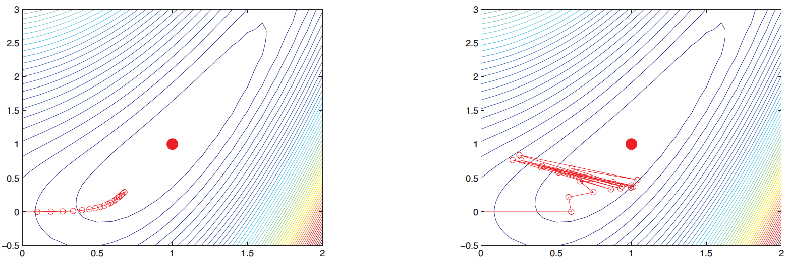
Gradient Descent
Small fixed η: convergence very slow
(gradients are perpendicular to level sets)
Notes:
The question is how small should we set eta? If we fix eta to be something small, then convergence is going to be very slow.
In this figure, the contours corresponds to the level set of the cost function f. So f along each contour is a constant value. Note that the gradients are perpendicular to these contours.
Each red circle corresponds to theta after each iteration. So we see the circles are moving closer to the red filled circle here corresponding to the local minimum.
At each iteration, our estimate of theta goes closer and closer to the local minimum. However as we approach the local minimum, the gradient becomes smaller and smaller, so for fixed eta, we update theta more and more slowly, so we see the circles are closer and closer together.

Slide 64
Gradient Descent
Small fixed η: convergence very slow
Big fixed η: might not converge
(gradients are perpendicular to level sets)
(gradients are perpendicular to level sets)
Notes:
If we fix eta to be a big number, then the problem is that we might not converge.
And the reason is that for small enough eta, we can ensure our cost function decreases at each iteration.
But if eta is big, we may change theta by too much, so the new theta might actually increase the cost function.
So in this example, here, we see that our estimate of theta oscillates around and never converges to the local minimum.
Therefore, what we want is to have eta changes adaptively at each iteration.

Slide 65
Gradient Descent
Notes:
This is the notion of line search. At iteration k + 1, we want to set eta such that it minimizes f of theta k + eta TIMES the descent direction. Where the descent direction is the negative of the gradient of f evaluated at theta k.
In other words, we are currently at theta k, and we want to take a step in the direction of the negative gradient. If we take a very small step, then the cost function only decreases by a small amount. If we take a big step, the cost function might actually increase. So we want a step size eta that minimizes the cost function as much as possible.
Since this is a one dimensional optimization problem, there are many ways to do this, which you can look up in numerical recipes in C, which is freely available on this website. My own favorite approach is golden section search. I really like the numerical recipes book because each recipe is very short and the rationale for each recipe is explained very concisely and easy to understand.

Slide 66
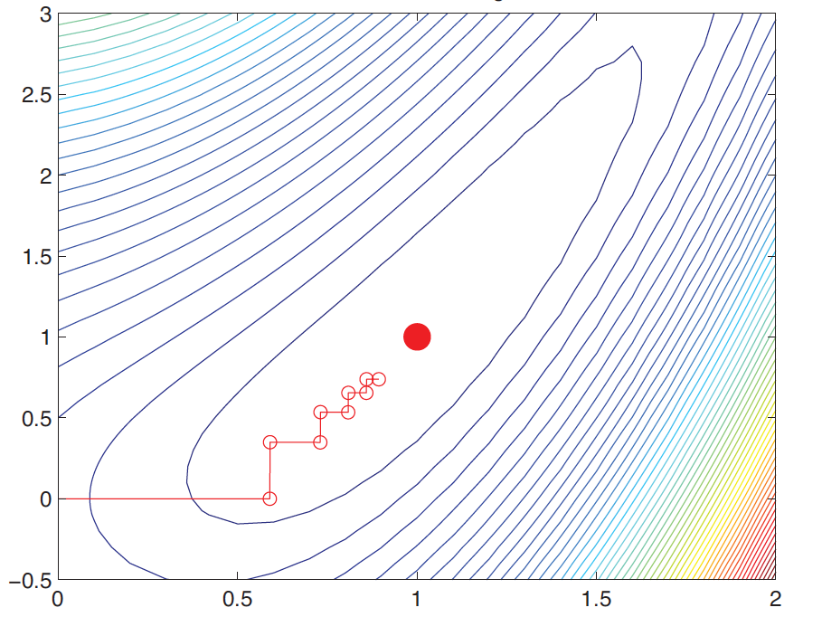
Gradient Descent
Notes:
The problem with steepest descent with line search is that the search path through parameter space is zig-zag, as illustrated by this figure.
This is the same figure as before, but now each iteration, eta is set to minimize the cost function.
We see that at first we take a big step, but then the step becomes smaller and smaller. But even then we are converging quite quickly to the local minimum.
However, we see that the path we are taking is zig-zag at 90 degrees, rather than a smooth path to the local minima. A more direct path might be able to speed up the optimization.

Slide 67
Gradient Descent
Notes:
Let’s first understand why the zig-zag occurs.
Let phi of eta be equal to f of thetak + eta d.
This is the cost function for our line search (from the previous bullet point). We want to find eta that minimizes phi of eta.

Slide 68
Gradient Descent
Notes:
IF we differentiate phi with respect to eta, we get d transpose TIMES the gradient of f evaluated at theta k + eta TIMES d.
This is just applying the chain rule for differentiation. Any questions?

Slide 69
Gradient Descent
Notes:
The derivative of phi at the best value of eta is equal to 0.

Slide 70
Gradient Descent
Notes:
But for the derivative to be 0, this could mean that gradient f is 0, which means that we are already at the local minimum of f(theta)

Slide 71
Gradient Descent
descent direction in current iteration
negative of descent direction at next iteration
Notes:
OR d is PERPENDICULAR to the gradient of f evaluated at the termination of our line search. This means that current descent direction d is PERPENDICULAR to our next descent direction.
Therefore we get this zig-zag path in our gradient descent.

Slide 72
Gradient Descent
Notes:
To avoid this zig-zag path, some people add a momentum term to the gradient descent.
So theta at k + 1 is equal to theta k MINUS eta k TIMES gradient of f evaluated at theta k. So far this is the same as steepest descent.
But now there is one more term mu k TIMES theta k MINUS theta k – 1. Where mu k is a number between 0 and 1. So rather than making a 90 degrees turn, we try to move a little in the same direction as before.
The hope is that the momentum term will smooth out the zig-zag path so we reach the local minimum faster.
For non-convex optimization problem, we also hope the momentum will bring us past some local minima to reach a better local minimum. <DRAW?>

Slide 73
Gradient Descent
Notes:
Yet another approach is called conjugate gradient descent. Again, you can find out more information about this in numerical recipes.
Numerical recipes suggest conjugate gradient descent even for non-convex minimization problem, but in my experience, it doesn’t help that much. But of course it’s possible that it works for your non-convex problems.
conjugate gradient descent is definitely awesome for minimizing quadratic cost functions theta TRANSPOSE A theta or finding the solutions of linear system A TIMES theta equal to b. In this case, conjugate gradient methods are proven to converge in D iterations where D is the dimensions of theta.

Slide 74
Newton’s Method
Notes:
Instead of just considering the first derivative, we can obtain more powerful approaches by considering the second derivatives.
The idea is to perform a taylor series expansion at theta k, our current estimates of theta.
So f of thetak + dk is approximately f of theta k + dk transpose TIMES the gradient of f PLUS 1/2 TIMES d k transpose TIMES the Hessian times dk.
Where the gradient and Hessian are both evaluated at theta k.
Let’s call this whole expression f quadratic.

Slide 75
Newton’s Method
Notes:
Let’s differentiate f quadratic with respect to dk and set it to 0.
The first term does not depend on dk so it disappears.
Differentiating dk transpose TIMES the gradient of f gives us gradient of f.
Differentiating half dk transpose TIMES H TIMES dk gives us H TIMES dk
Setting the derivative to 0, we get dk to be NEGATIVE the Hessian inverse TIMES the gradient of f.

Slide 76
Newton’s Method
Notes:
Suppose the Hessian is positive definite, then the minimum of f quadratic is achieved when dk is equal to MINUS hessian inverse TIMES The gradient.
This is not true if the hessian is negative definite.

Slide 77
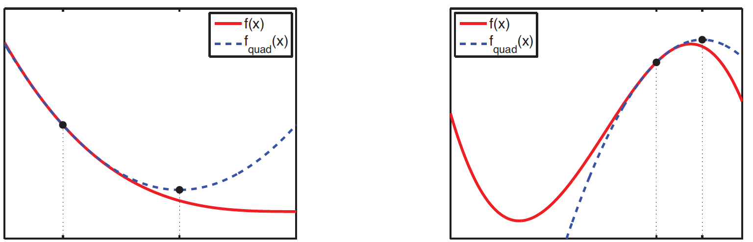
Newton’s Method
H positive definite
H negative definite
Notes:
As illustrated as follows. So here the red curves correspond to f of theta.
So what f quadratic is doing is to fit a quadratic curve at theta k. That correspond to the blue curve.
If the hessian is positive definite, then the quadratic curve is convex, in which case, the local minimum is given by dk equal to MINUS Hessian inverse TIMES the gradient.
If the hessian is negative definite, then the quadratic curve is concave, in which case, setting dk to be negative Hessian inverse TIMES the gradient actually gives us the maximum, rather than the minimum of f quadratic

Slide 78
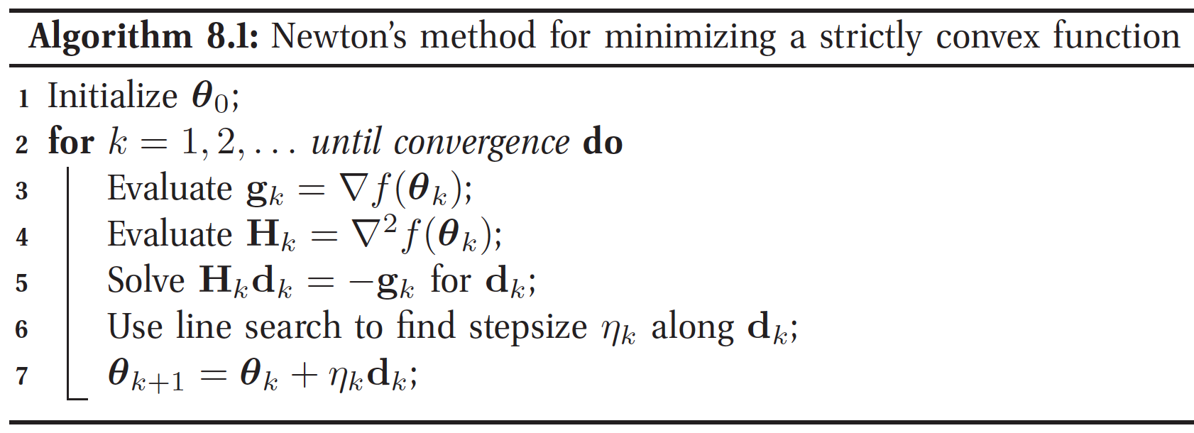
Newton’s Method
Notes:
This motivates the newton method, where theta k + 1 is equal to theta k + eta k TIMES dk, where dk is found by solving the linear system Hessian H at iteration k TIMES dk equal to the negative of the gradient at iteration k.
So we can summarize the algorithm here. We initialize theta to be theta0.
For iteration k from 1, 2 until convergence, we compute the gradient and hessian of f at the current estimate of theta, theta k
We then solve the linear equations Hk TIMES dk equal to the negative of the current gradient.
We then use line search to find the step size eta k.
And we update theta k + 1 to be theta k + eta k TIMES dk.

Slide 79
Newton’s Method
Notes:
H has to be positive definite, in order to guarantee that dk is a descent direction.

Slide 80
Newton’s Method
Notes:
To see this, let’s consider the inner product between the steepest descent direction NEGATIVE the gradient AND negative hessian inverse TIMES gradient of f.
If the hessian is positive definite, the hessian inverse is also positive definite, so the inner product will be greater than 0.
Since the inner product is greater than 0, this means NEGATIVE Hessian inverse TIMES gradient of f is within 90 degrees of steepest descent direction (draw?).
Which means that if eta is small enough, dk will decrease the cost function f.

Slide 81
Newton’s Method
Notes:
If Hessian is not positive definite, then we can use the levenberg-marquardt algorithm if our cost function is in the form of nonlinear least squares.
The levenberg-marquardt algorithm is a hybrid between the steepest descent and newton’s optimization. I highly recommend it if you have a nonlinear least squares problem to minimize. In my experience, It works very very well.
Wikipedia has an easy explanation for the algorithm.

Slide 82
Quasi-Newton Methods: BFGS
Notes:
The problem with the Newton method is that even when the hessian is positive definite, it is usually very expensive to compute the Hessian and its inverse in order to compute Hessian inverse TIMES the gradient g.

Slide 83
Quasi-Newton Methods: BFGS
Notes:
One famous approximation is called the BFGS low rank approximation to the Hessian.
Where the Hessian at k+1 is approximated to be this matrix Bk+1 which is equal to B at previous iteration k (Bk) + these two matrix terms of rank two.
B is initialized to be the identity matrix.

Slide 84
Quasi-Newton Methods: BFGS
Notes:
But of course, even if we have an approximation to the Hessian, we still need to invert it, which is quite expensive.
So instead we can simply keep track of the Hessian inverse.
And we can do so using the Sherman-Morrison inversion lemma, which tells us how to write the inverse of a matrix A + u TIMES v transpose as a function of A inverse and u and v transpose.
So if we imagine A to be the B in BFGS, this means that given B k inverse, we can easily compute B k+1 inverse WITHOUT having to compute B k +1 and then invert it.

Slide 85
Quasi-Newton Methods: BFGS
Notes:
But of course, B inverse is still a D by D matrix, where D is the number of features, so this still requires order D square of memory.

Slide 86
Quasi-Newton Methods: BFGS
Notes:
In limited memory BFGS, we can approximate Hessian inverse TIMES g directly using the most recent m pairs of sk and yk.
So therefore the memory usage is only order m TIMES D
Typically m is set to be about 20.

Slide 87
Questions
Notes:
Any questions?

Slide 88
Optimizing Logistic Regression Parameters + Need For a Bias Term
Notes:
Now let’s apply what we learn to optimize the negative log likelihood.

Slide 89
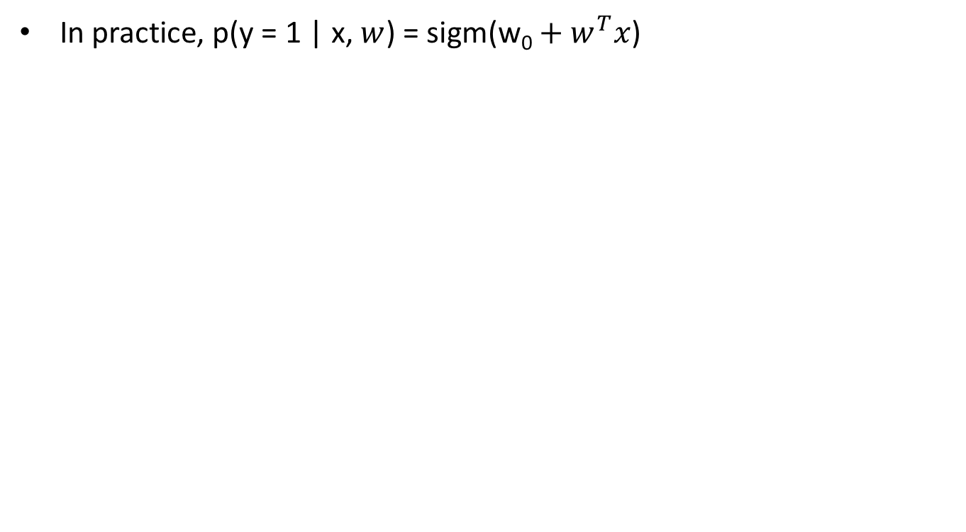
Quick Interlude: Why we need bias term?
In practice, p(y = 1 | x, $w$) = sigm(${\text{w}\text{0}+w}^{T}x$)
Notes:
First note that we actually want to model the probability that y is equal to 1 given x and w to be the SIGMOID of w0 + w transpose x. w0 is called the offset or bias term.
Why do we need this offset term?

Slide 90
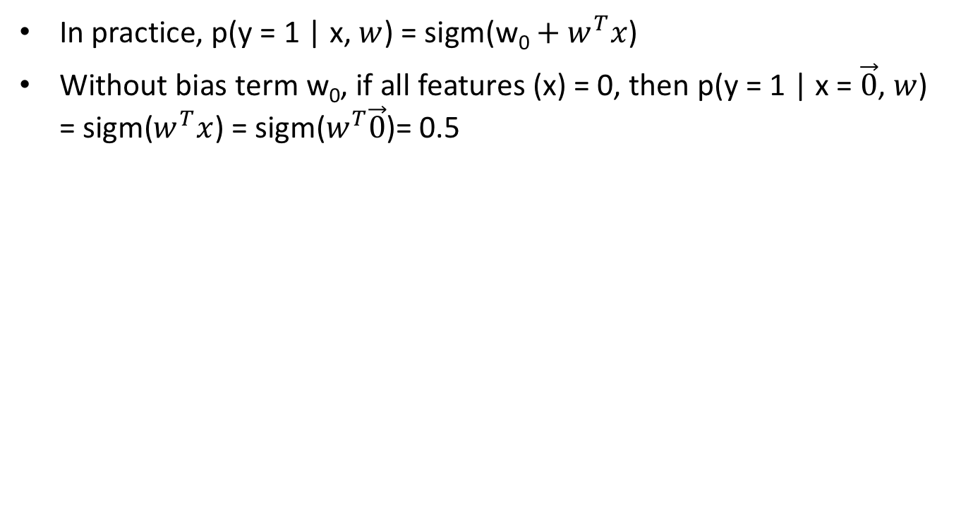
Quick Interlude: Why we need bias term?
In practice, p(y = 1 | x, $w$) = sigm(${\text{w}\text{0}+w}^{T}x$)
Without bias term w₀, if all features (x) = 0, then p(y = 1 | x = $\vec{0}$, $w$) = sigm($w^{T}x$) = sigm($w^{T}\vec{0}$)= 0.5
Notes:
Without the bias term w0, suppose all features are equal to 0, so x is a zero vector.
Then the posterior distribution of y is equal to sigmoid of w TRANSPOSE times the 0 vector, which is equal to 0.5.

Slide 91
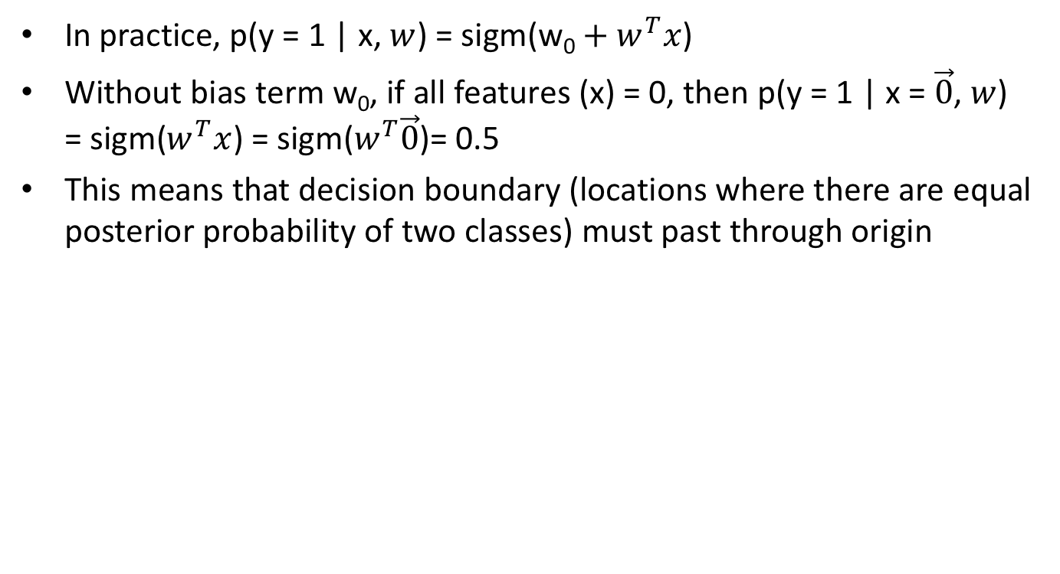
Quick Interlude: Why we need bias term?
In practice, p(y = 1 | x, $w$) = sigm(${\text{w}\text{0}+w}^{T}x$)
Without bias term w₀, if all features (x) = 0, then p(y = 1 | x = $\vec{0}$, $w$) = sigm($w^{T}x$) = sigm($w^{T}\vec{0}$)= 0.5
This means that decision boundary (locations where there are equal posterior probability of two classes) must past through origin
Feature 2: x₂
Feature 1: x₁
Notes:
This means that the decision boundary passes through the origin.
Remember the decision boundary is where the posterior probability of two classes are the same.
So on one side of the decision boundary, we classify the data as from one class. On the other side of the decision boundary, we classify data as from the other class.

Slide 92
Quick Interlude: Why we need bias term?
In practice, p(y = 1 | x, $w$) = sigm(${\text{w}\text{0}+w}^{T}x$)
Without bias term w₀, if all features (x) = 0, then p(y = 1 | x = $\vec{0}$, $w$) = sigm($w^{T}x$) = sigm($w^{T}\vec{0}$)= 0.5
This means that decision boundary (locations where there are equal posterior probability of two classes) must past through origin
No decision boundary passes through origin & separates the two classes (triangles and stars)
Feature 2: x₂
Feature 1: x₁
Notes:
However, suppose we have two classes triangles and stars.
Notice that there are no decision boundary that passes through the origin and can separate the stars and triangles?
This is why we need the bias term w0.

Slide 93
Newton’s Method for Logistic Regression
Notes:
We now apply Newton’s method for logistic regression.
These equations are copied from the previous slide. Because the Hessian is positive definite in logistic regression, this is awesome because this means we can use Newton’s method for optimization.

Slide 94
Newton’s Method for Logistic Regression
Notes:
To incorporate this bias term, the easiest thing to do, is to concatenate 1 to the start of each feature vector xi, so each feature vector is now of length D+1.
So across all datapoints, the first feature has a value of 1. Does this make sense?

Slide 95
Newton’s Method for Logistic Regression
Notes:
And then the model is still the same as before: p of yi = 1 given xi and w is equal to sigmoid of w TRANSPOSE xi.
However, notice that xi on the right hand side is now the modified xi?
And the modified w is now a (D+1) x 1 vector. So the first element of w is now the bias term.

Slide 96
Newton’s Method for Logistic Regression
Notes:
We can then compute the gradient and Hessian using the above formulas, but now we are using the modified x with the extra 1 concatenated and w becomes the modified w.
So for example X transpose is now the concatenation of the modified xi.

Slide 97
Newton’s Method for Logistic Regression
Notes:
And we initialize the algorithm by setting w to be all zeros.

Slide 98
Newton’s Method for Logistic Regression
Notes:
We then repeatedly update w until convergence using the Newton’s update equation.
For simplicity, the step size is set to 1. In fact, for the assignment, you can set step size to be 1. It will work.
Any questions?

Slide 99
Questions
Notes:
Any questions?

Slide 100
One More Modification: Regularization (Regularizations are additional constraints to reduce overfitting)
Notes:
We are almost done, but not quite. In the current form, logistic regression will not work well. We still need some regularization.
If you have not heard of the term regularization, in general regularization means additional constraints to reduce overfitting.

Slide 101
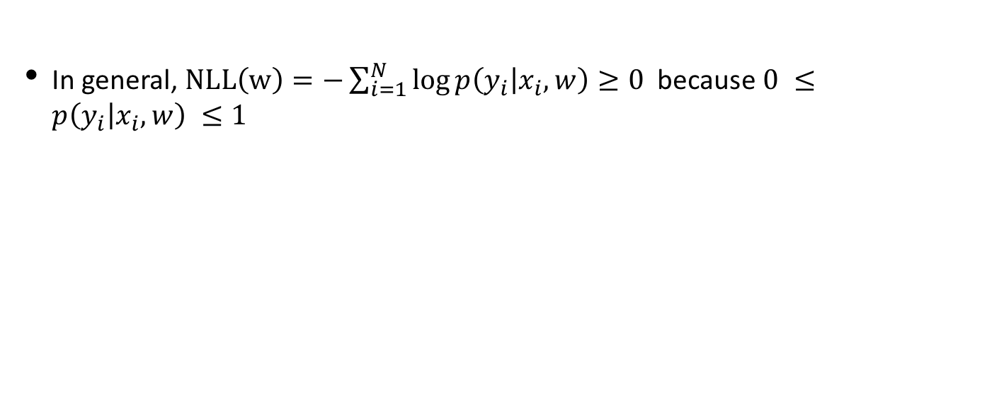
Why do we need regularization?
In general, $NLL\left(w\right)=−\sum_{i=1}^{N}{\log{p\left(y_{i} | x_{i}, w\right)}≥0 }$ because $0 ≤p\left(y_{i} | x_{i}, w\right) ≤1$
Notes:
First, note that the negative low likelihood is greater than or equal to 0.
Because y is a discrete variable, so p of y_i given x_i and w is between 0 and 1.
Which means the log is between –infinity to 0, which means the negative sum becomes a number between 0 and infinity.

Slide 102
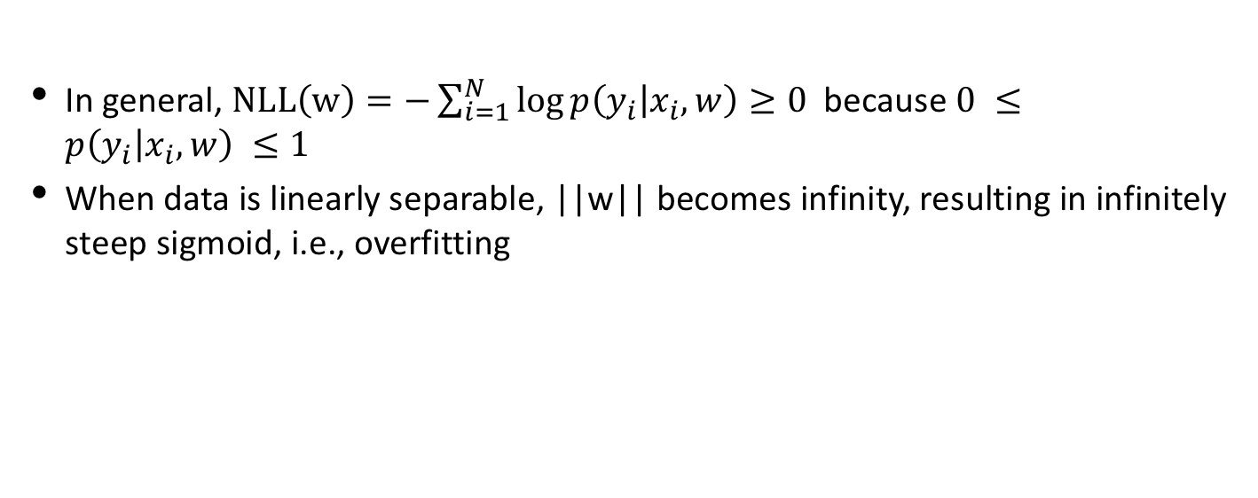
Why do we need regularization?
In general, $NLL\left(w\right)=−\sum_{i=1}^{N}{\log{p\left(y_{i} | x_{i}, w\right)}≥0 }$ because $0 ≤p\left(y_{i} | x_{i}, w\right) ≤1$
When data is linearly separable, ||w|| becomes infinity, resulting in infinitely steep sigmoid, i.e., overfitting
Notes:
Suppose our training data is linearly separable. Then the best solution is achieved when we scale w to be very very big.
This corresponds to having a very steep sigmoid.
So essentially on one side of the decision boundary the posterior probability is 0. The moment we cross the decision boundary, the posterior probability becomes 1. Which is obviously overfitting.
Let me illustrate why this is the case

Slide 103
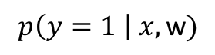
Why do we need regularization?
In general, $NLL\left(w\right)=−\sum_{i=1}^{N}{\log{p\left(y_{i} | x_{i}, w\right)}≥0 }$ because $0 ≤p\left(y_{i} | x_{i}, w\right) ≤1$
When data is linearly separable, ||w|| becomes infinity, resulting in infinitely steep sigmoid, i.e., overfitting
$$p\left(y=1 \right| x, \text{w})$$
1
0
Class 0
Class 1
Feature x
Notes:
Suppose our features are one-dimensional.
Triangles are from class 0 and stars are from class 1.

Slide 104
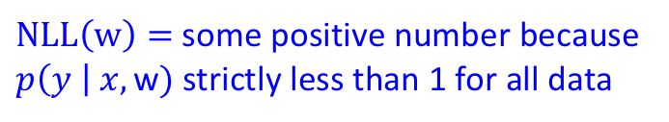
Why do we need regularization?
In general, $NLL\left(w\right)=−\sum_{i=1}^{N}{\log{p\left(y_{i} | x_{i}, w\right)}≥0 }$ because $0 ≤p\left(y_{i} | x_{i}, w\right) ≤1$
When data is linearly separable, ||w|| becomes infinity, resulting in infinitely steep sigmoid, i.e., overfitting
$$p\left(y=1 \right| x, \text{w})$$
1
$NLL\left(w\right)=$some positive number because $p\left(y \right| x, \text{w})$ strictly less than 1 for all data
0
Class 0
Class 1
Feature x
Notes:
Let’s say w is such that we have this blue sigmoid curve.
Notice that the posterior probability is strictly less than 1 for all data points, which means that the Negative log likelihood will be some positive number.

Slide 105
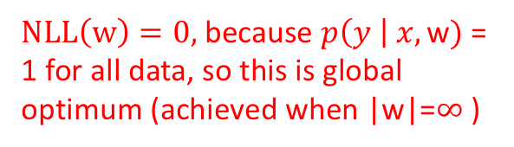
Why do we need regularization?
In general, $NLL\left(w\right)=−\sum_{i=1}^{N}{\log{p\left(y_{i} | x_{i}, w\right)}≥0 }$ because $0 ≤p\left(y_{i} | x_{i}, w\right) ≤1$
When data is linearly separable, ||w|| becomes infinity, resulting in infinitely steep sigmoid, i.e., overfitting
$NLL\left(w\right)=0,$because $p\left(y \right| x, \text{w})$ = 1 for all data, so this is global optimum (achieved when |w|=$∞$ )
$$p\left(y=1 \right| x, \text{w})$$
1
$NLL\left(w\right)=$some positive number because $p\left(y \right| x, \text{w})$ strictly less than 1 for all data
0
Class 0
Class 1
Feature x
Notes:
Let’s consider a different w, which results in this red curve.
This red curve actually has a negative log likelihood of 0 because the posterior probability is exactly equal to 1 for all data.
Therefore, this w is a global optimum for this data. And this is achieved with when the norm of w is infinity.

Slide 106
Why do we need regularization?
In general, $NLL\left(w\right)=−\sum_{i=1}^{N}{\log{p\left(y_{i} | x_{i}, w\right)}≥0 }$ because $0 ≤p\left(y_{i} | x_{i}, w\right) ≤1$
When data is linearly separable, ||w|| becomes infinity, resulting in infinitely steep sigmoid, i.e., overfitting
$NLL\left(w\right)=0,$because $p\left(y \right| x, \text{w})$ = 1 for all data, so this is global optimum (achieved when |w|=$∞$ )
$$p\left(y=1 \right| x, \text{w})$$
1
$NLL\left(w\right)=$some positive number because $p\left(y \right| x, \text{w})$ strictly less than 1 for all data
0
Class 0
Class 1
Feature x
Super confident this is class 0
Super confident this is class 1
Notes:
The problem is that this classifier is over-confident.
Basically the classifier will be very confident that any data on the left side of the decision boundary is from class 0 and any data on the right side of the decision boundary is from class 1.
So, we do NOT want w to be too big.

Slide 107

$l$₂ Regularization
Notes:
So what we can do is to add a l2 regularization term: half TIMES lambda w transpose TIMES w to the Negative Log likelihood.
For a positive lambda, if w is big then lambda w transpose w is a big number so the new cost function becomes big. Since we are minimizing the cost function, this means that big w is discouraged.

Slide 108
$l$₂ Regularization
Notes:
The new gradient is given by the old gradient PLUS lambda w. This is the reason why we add 1/2 to the regularization so the derivative will work out to be without the half.
And the new Hessian is given by the old Hessian PLUS lambda TIMES the identity matrix.
Therefore we can easily use the same Newton’s algorithm as before, but with this new regularized gradient and Hessian.

Slide 109
But we do not want to regularize bias term
Notes:
BUT there is another wrinkle.
We actually do not want to regularize the bias term w0.

Slide 110
But we do not want to regularize bias term
Notes:
To show you why, suppose the features are 2-dimensional, so x1 and x2.

Slide 111
But we do not want to regularize bias term
Notes:
The decision boundary corresponds to set of x1 and x2 where the posterior probability is 0.5.
This means sigmoid of w0 + w1 x1 + w2 x2 = 0.5.

Slide 112
But we do not want to regularize bias term
Notes:
This means w0 + w1x1 + w2x2 is equal to 0.

Slide 113
But we do not want to regularize bias term
Notes:
If we rearrange the term, this means that the decision boundary corresponds to x2 = MINUS w1/w2 TIMES x1 MINUS w0/w2

Slide 114
But we do not want to regularize bias term
Notes:
So if we put l2 regularization on w0, this means that we are encouraging w0 to be small, which means the intercept MINUS w0/w2 will be small should means that the boundary should pass close to the origin.
Why is that a problem?

Slide 115
But we do not want to regularize bias term
Feature 2: x₂
Best decision boundary separating triangles & stars
0
0
Feature 1: x₁
Notes:
Imagine that we have two classes: triangles and stars.
This black decision boundary is the best one passing through the origin.

Slide 116
But we do not want to regularize bias term
If we shift feature 2 by -500 (or some other big negative number), to maintain decision boundary (with same slope), then w₀ needs to be big. But if we penalize w₀, then this is discouraged
Feature 2: x₂
-500
0
Feature 1: x₁
Notes:
But now, suppose we offset feature 2 by -500 or some other big negative number, then we want to translate the decision boundary down, so the intercept is now at -500.
But this means that w0 now needs to be big. But if we penalize w0, then this is discouraged.

Slide 117

Exclude Bias from $l$₂ Regularization
Notes:
So instead we exclude w0 from the regularization.
So the regularization consists of ½ TIMES lambda TIMES w TRANSPOSE w.
Again, just to recall, the bold w is a (D+1) x 1 vector, where the first element corresponds to the bias term w0.
The non-bolded w is a D x 1 vector without the bias term.
So the regularization on the non-bolded w.

Slide 118
Exclude Bias from $l$₂ Regularization
row is all zero
column is all zero
Notes:
The new gradient is given by the old gradient PLUS lambda TIMES this D x 1 vector, where the first element is 0 because the regularization is not applied to the bias term, and the remaining vector is just the D x 1 non-bolded w.
And the new Hessian is given by the old Hessian PLUS lambda TIMES a (D+1) x (D+1) matrix. The first column and first row are just zeros. The bottom right hand corner is a D x D identity matrix.

Slide 119
Multi-class Logistic Regression
Notes:
We can easily generalize binary logistic regression to multiple classes.
In this case, the probability that y is equal to class c is equal to e to the power of w c transpose TIMES x DIVIDED by sum from c’ equal to 1 to capital C e to the w c prime transpose TIMES x.
We see that this is very similar to before except that we have a different w for each class AND essentially the denominator ensures the left hand side is a probability distribution.

Slide 120
Multi-class Logistic Regression
Notes:
We can still compute the first and second derivatives but things are a lot messier.

Slide 121
Multi-class Logistic Regression
Notes:
Because the size of the Hessian is now order CD by CD, so it can be quite big.
So in that case, the low memory BFGS might work better than Newtons’ method.

Slide 122
Multi-class Logistic Regression
Notes:
You can find more details in Kevin Murply textbook.

Slide 123
Logistic Regression vs LDA
Notes:
Before I conclude this section on logistic regression, I want to compare the 2-class linear discriminant analysis with logistic regression.
Recall that for 2-class LDA, we can write the probability that class label y is equal to 1 given x and theta to be the sigmoid of w transpose TIMES x MINUS x0.
This expression is of course very similar to logistic regression.

Slide 124
Summary
Discriminative Classifier p(y | x, w): Logistic Regression
Notes:
Today, I introduce to you the first discriminative classifier: logistic regression.

Slide 125
Summary
Discriminative Classifier p(y | x, w): Logistic Regression
Numerical optimization
Gradient descent
Notes:
The cost function negative log likelihood cannot be optimized in close form, so I took the chance to introduce certain numerical optimization approaches, including gradient descent

Slide 126
Summary
Discriminative Classifier p(y | x, w): Logistic Regression
Numerical optimization
Gradient descent
Newton’s method
Notes:
And Newton’s method

Slide 127
Summary
Discriminative Classifier p(y | x, w): Logistic Regression
Numerical optimization
Gradient descent
Newton’s method
Hessian positive definite everywhere => cost function convex => unique global minimum and every local minimum is global minimum
Notes:
I also explained that if the Hessian is positive definite everywhere, this would imply the cost function is convex, which implies that it has a unique global minimum and every local minimum is a global minimum.

Slide 128
Summary
Discriminative Classifier p(y | x, w): Logistic Regression
Numerical optimization
Gradient descent
Newton’s method
Hessian positive definite everywhere => cost function convex => unique global minimum and every local minimum is global minimum
Logistic regression
NLL is convex – optimize with Newton’s method
Notes:
In the case of logistic regression, the cost function Negative Log Likelihood is convex, so we can optimize with Newton’s method

Slide 129
Summary
Discriminative Classifier p(y | x, w): Logistic Regression
Numerical optimization
Gradient descent
Newton’s method
Hessian positive definite everywhere => cost function convex => unique global minimum and every local minimum is global minimum
Logistic regression
NLL is convex – optimize with Newton’s method
Bias term
Regularization
Notes:
However, we first have to include a bias term and l2 regularization.

Slide 130
Optional Reading
Notes based on
KM Chapter 8.1, 8.3, 8.3 (beware of typos)

